Slide 1
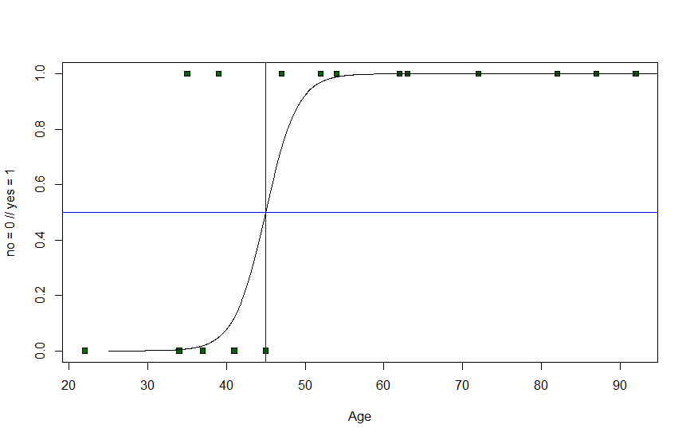
Important p-z-pairs

Slide 2
Normal distribution

Slide 3
Normal distribution
84.1%

Slide 4
Normal distribution
68.3% (1σ around the mean)
95.4% (2σ around the mean)
99.7% (3σ around the mean)

Slide 5
One-tailed test
p= 0.05 ⬄ z = +/-1.64

Slide 6
One-tailed test
p= 0.05 ⬄ z = +/-1.64
p= 0.025 ⬄ z = +/-1.96

Slide 7
One-tailed test
p= 0.01 ⬄ z =+/- 2.32
p= 0.05 ⬄ z = 1.64
p= 0.025 ⬄ z = +/-1.96

Slide 8
Two-tailed test
p= 0.05 ⬄ z = +/-1.96
p= 0.025 ⬄ z = +/-2.24
p= 0.01 ⬄ z = +/-2.58

